Slide 1
Netflix Movies and TV Shows
Oleh:
Fahrul Rozi
Febriana Sulistya
Fauni Ambarsari

Slide 2
Business Understanding
Clear Questions
What content is available in different countries?
How is the similar content based on matching text-based features?
Is Netflix has increasingly focusing on TV rather than movies in recent years?
What is the popular genre of Netflix Movies and TV Shows?
What about the duration of the movies on Netflix? What can be concluded?
What about the titles of TV shows and movies on Netflix? What words are often shown?

Slide 3
Business Understanding
Measurable Outcome
Type of content in different country.
Some content that has similarities in Netflix.
The number of movies and tv shows produced over the last 10 years.
The genre of movies and tv shows are mostly produced.
Distribution visualization curve of Movies duration on Netflix.
Worldcloud of Netflix content titles both TV shows and Movies

Slide 4
Analytic Approach
Descriptive
Present the data in the graphs, diagrams, and so on to provide information characteristics of the data.
Statistical Analysis
Apply statistics to answer the problem questions.

Slide 5
Data Requirements
Question 1: type of Netflix’s content in each country
Question 2: the title, directior, listed_in, and description of TV shows and movies on Netflix
Question 3: release date of movies and TV shows on Netflix.
Question 4: genre of movies and TV shows on Netflix.
Question 5: duration of movies on Netflix.
Question 6: the title of movies and TV shows on Netflix.

Slide 6
Data Collection
Data is collected from kaggle at:
https://www.kaggle.com/shivamb/netflix-shows

Slide 7
Data Understanding
The dataset consists of meta details about the movies and tv shows such as the title, director, and cast of the shows / movies, and details such as the release year, the rating, duration, and description of the movies or TV shows.

Slide 8
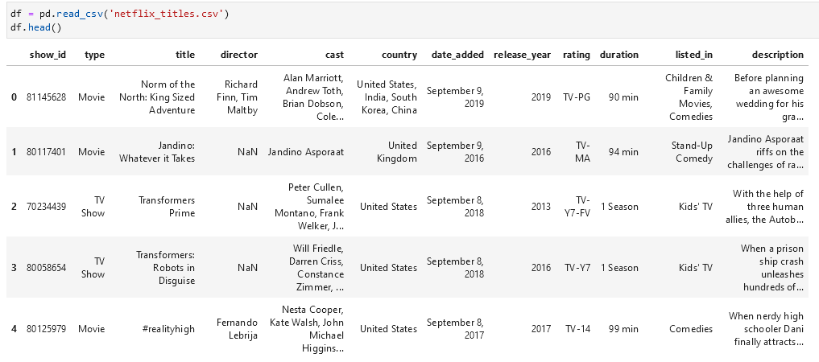
Data Understanding

Slide 9
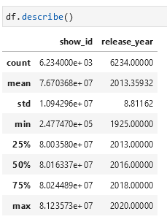
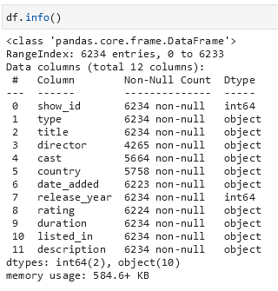
Data Understanding

Slide 10
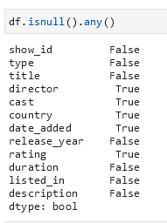
Data Preparation
Data Cleaning
Check missing value
Notes:
Ntar ditambahin jadinya yang missing value digimanain

Slide 11
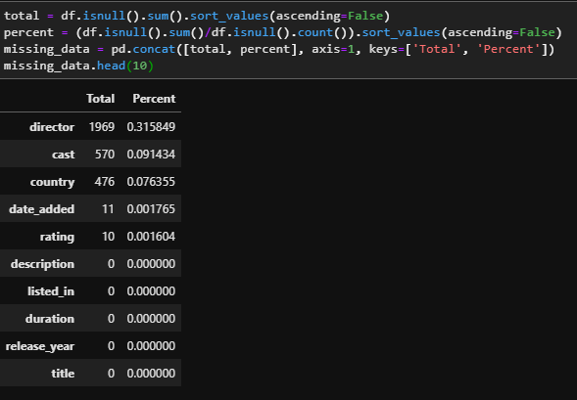
Data Preparation
Calculate missing values

Slide 12
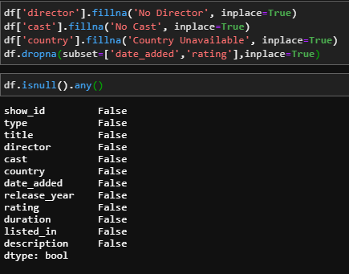
Data Preparation
Replace missing value

Slide 13
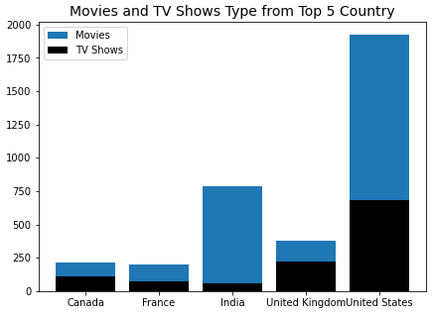
Question 1: What content is available in different countries?
Untuk menjawab problem tersebut, dilakukan perbandingan data feature dari masing-masing negara. Karena pada dataset terdapat 113 Negara yang berbeda, maka diambil 5 negara dengan jumlah show paling banyak, yaitu United States, India, United Kingdom, Canada, dan France

Slide 14
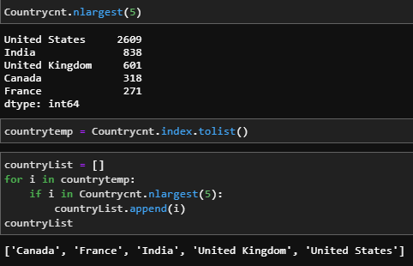
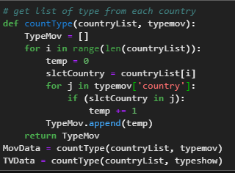
Question 1: What content is available in different countries?
Get top 5 country name and value for each country in TV Shows and Movies

Slide 15
Question 2: How is the similar content based on matching text-based features?
Untuk menjawab problem tersebut, dilakukan pengambilan feature text dari dataset, yaitu title, director, listed_in, dan description. Semua feature ini digabung sehingga membentuk sebuah informasi baru yang disimpan dengan nama movies_info.
Data feature text ini dilakukan preprocessing dengan menggunakan library nltk untuk stopwords removal, punctuation, dan juga lemmatization. Setelah data dilakukan preprocessing, dicari similar movies dengan menggunakan cosine similarity.

Slide 16

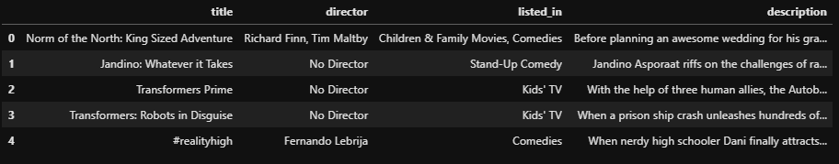
Question 2: How is the similar content based on matching text-based features?
Dataset preparation :

Slide 17
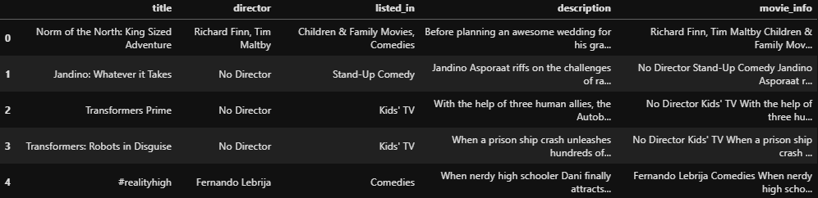
Question 2: How is the similar content based on matching text-based features?
Here is the combined dataset to make movie_info :

Slide 18

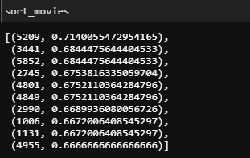
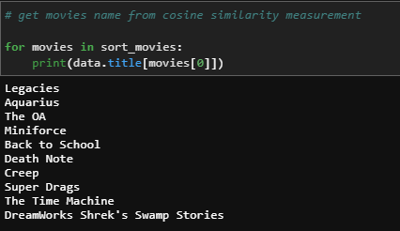
Question 2: How is the similar content based on matching text-based features?
Here is the result :

Slide 19
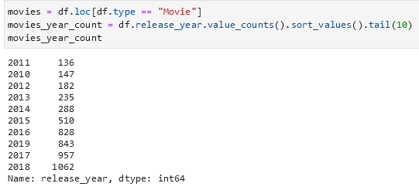
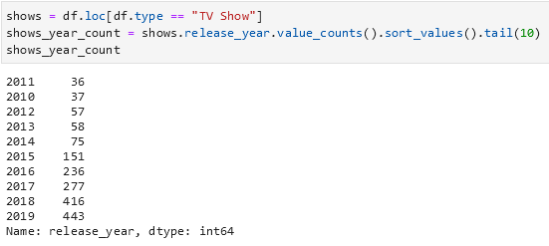
Question 3: Is Netflix has increasingly focusing on TV rather than movies in recent years?

Slide 20
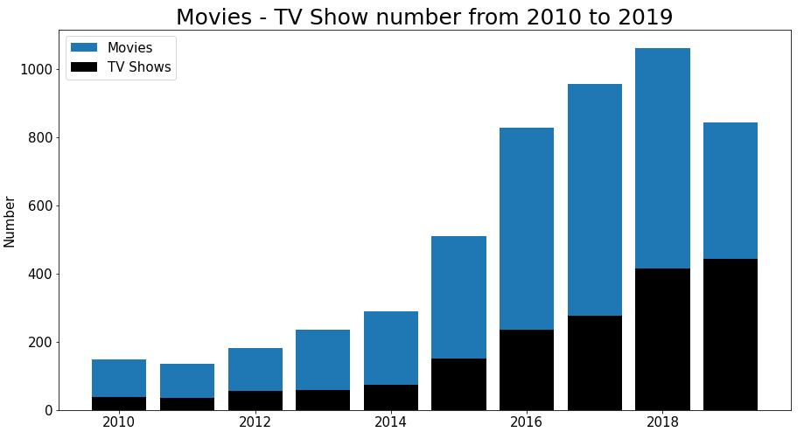

Slide 21
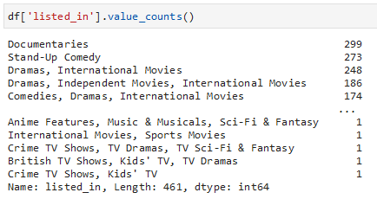
Question 4: What is the popular genre of Netflix Movies and TV Shows?
Check out the content in the column “listed_in”.

Slide 22
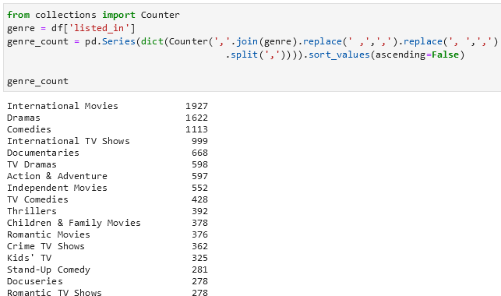
Question 4: What is the popular genre of Netflix Movies and TV Shows?
Split each genre in column “listed_in”.

Slide 23
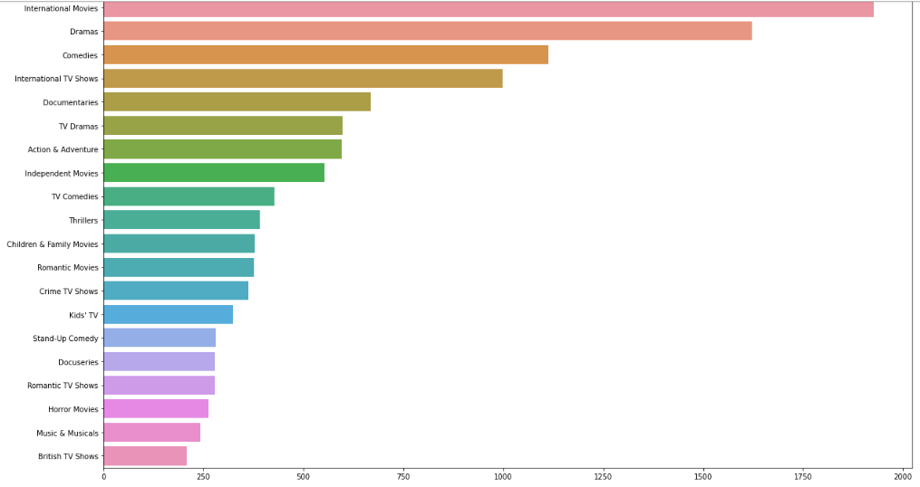

Slide 24
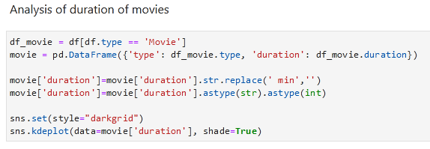
Question 5: What about the duration of the movies on Netflix?
Untuk menjawab problem tersebut, langkah yang dilakukan adalah membuat kurva mengenai distribusi dari durasi Movies pada Netflix.

Slide 25
Question 5: What about the duration of the movies on Netflix?
Sebelum memvisualisasikan durasi Movies, dilakukan preprocessing untuk kemudian menghilangkan satuan waktu dan mengubahnya menjadi tipe data integer. Dengan menggunakan fungsi kernel density estimate plot pada library Seaborn, diperoleh visualisasi sebagai berikut.

Slide 26
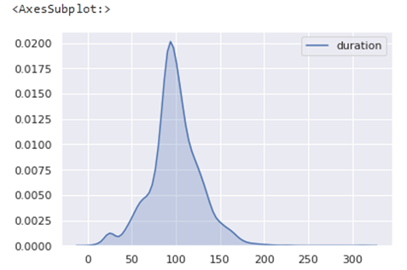
Question 5: What about the duration of the movies on Netflix?
Jadi, sebagian besar content Movies di Netflix termasuk dalam durasi sekitar rentang 75-120 menit. Hal ini dapat diterima mengingat banyak penonton yang tidak dapat menonton film berdurasi sampai 3 jam dalam sekali duduk.

Slide 27
Question 6: What about the titles of TV shows and movies on Netflix?
Untuk menjawab problem tersebut, langkah yang dilakukan adalah membuat wordcloud dari judul TV shows maupun Movies pada Netflix untuk memudahkan kita menemukan kata pada judul yang paling sering digunakan.

Slide 28
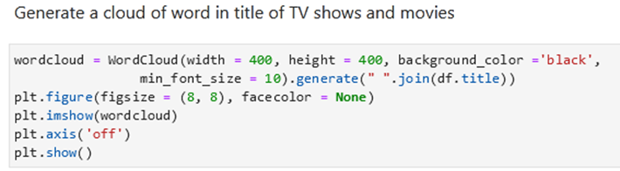
Question 6: What about the titles of TV shows and movies on Netflix?
Dengan menggunakan salah satu tools visualisasi yang mudah dipahami yaitu Wordcloud, diperoleh tampilan kata yang digunakan pada judul content Netflix sebagai berikut.

Slide 29
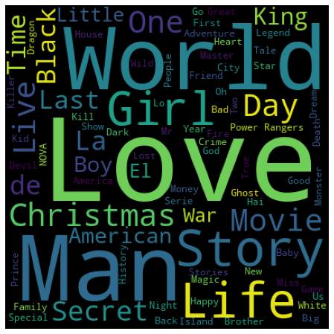
Dari hasil tersebut, kita dapat mengetahui dengan mudah dan cepat mengenai kata-kata yang sering dipakai dalam judul-judul TV shows dan Movies pada Netflix. Semakin besar ukuran kata, semakin sering kata tersebut digunakan.

